Slide 1
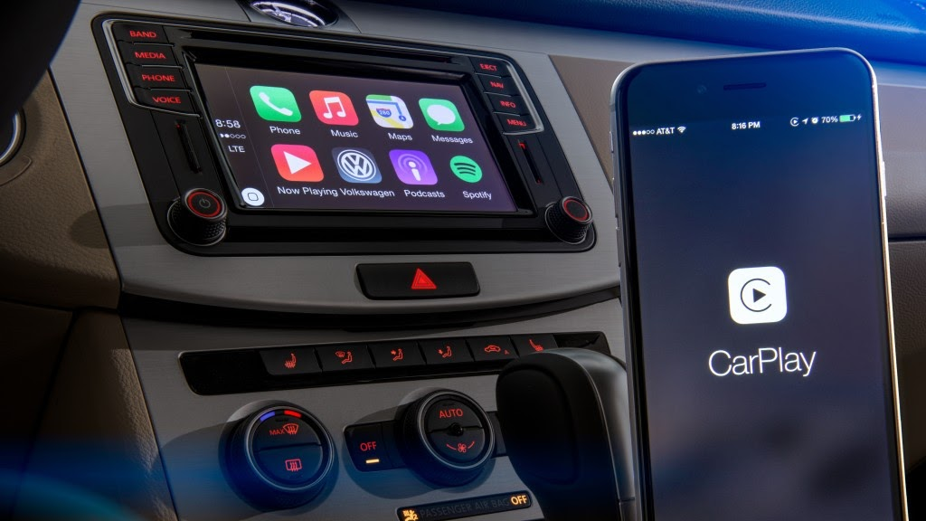


MALWA INSTITUTE OF TECHNOLOGY
MINOR PROJECT PRESENTATION ON :
AUTO RESCUE : AUTOMATED AMBULANCE DISPATCH SYSTEM
Guided by :
Vijay Malvia Sir
H.O.D. of IT Department
Presented By : Group 6 Members
Lokesh Vishwakarma
Bhupendra Vishwakarma
Deepak Rathor
Branch: IT
Year : 3rd
This Photo by Unknown author is licensed under CC BY.

Slide 2

Content :
Algorithm
Flow Chart
Circuit Used in Design
z
This Photo by Unknown author is licensed under CC BY-SA.

Slide 3

ALGORITHM :
Algorithm to implement Auto Rescue system
to make emergency call.
z

Slide 4
Start
2. Take sensor reading
3. Check reading
If ( ( A>AT && N>NT)
| |
(T>TT && N>NT) )
4. If the condition is false then continue from start
5. If the condition is true then
6. Turn on ALARM
If (ALARM == Cancel)
Stop the alarm and continue from start
Else
Take GPS coordinates then continue from step (7)
7. Send text Message and Current Location
8. END
Denotation :
Accelerometer reading = A
Accelerometer Threshold = AT
Noise reading = N
Noise Threshold = NT
Tilt sensor reading = T
Tilt sensor Threshold = TT
z

Slide 5

FLOW CHART
z

Slide 6
START
Take sensors reading
False
If(A>AT&&
N>NT)
If(T>TT&&
N>NT)
True
False
True
ALARM for 30sec
If(ALARM==cancel)
False
Take location
Send location to Emergency number
True
END

Slide 7

CIRCUITS USED IN DESIGN
z

Slide 8
Circuit Used For Crash Detection​
S.NO | Sensors | Work | Threshold Limit
​ 1​ | ​Noise Sensor ​ | ​Is will used to detect the threshold intensity of sound which us caused by accident.​
​ 2​ | ​Tilt Sensor ​ | ​Tilt sensors measure the tilting position with reference to gravity and are used in numerous applications.​ | 45 degree
​ 3​ | ​Impact Sensor​ ​ ​ | It ​measures acceleration in three dimensions. You can use it to detect motion, vibrations, or changes in orientation.​

Slide 9
Other Circuits Used For Crash Detection
S.NO | Sensor Name | Work
1 | ​Arduino Nano (ADXL-345) | ​The Arduino Nano can be programmed to control various electronic circuits and devices. It's commonly used in DIY electronics projects for tasks like reading sensors, controlling motors, or interfacing with other modules.
2 | ​GSM-Module (SIM800L) | ​This module enables to connect to the cellular network. It's used for sending SMS messages, making phone calls, or establishing internet connections
​3 | ​GPS-Module (NEO-6M) | ​The GPS module provides accurate location and time data.
4 | Voltage Regulator (LM2596) | The LM2596 module is used to step down a higher input voltage to a stable and lower output voltage

